Slide 1
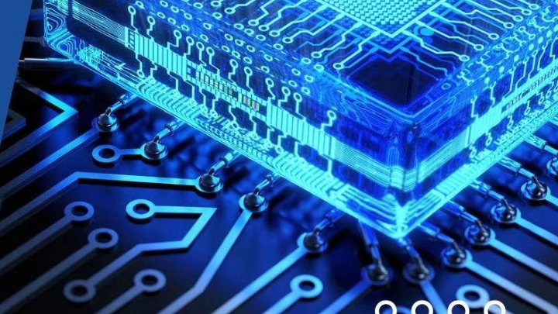
5 stages pipelined MIPS Architecture
Εργασία Ψηφιακών Συστημάτων
Χρήστος Ντούμας
Α.Ε.Μ.: 10095

Slide 2
MIPS Overview
MIPS, which stands for Microprocessor without Interlocked Pipeline Stages, is a type of microprocessor architecture using 32 bits instructions. It's a core component of the Reduced Instruction Set Computing (RISC) approach, known for its focus on simplicity and speed. MIPS processors are designed to execute simple instructions in a single clock cycle, utilizing a pipeline to overlap different stages of instruction execution.
A pipeline is a technique used to improve processor performance by overlapping the execution of multiple instructions. Each instruction goes through a series of stages (like fetching, decoding, executing, memory access, and writing back).
The "without interlocked pipeline stages" part means the MIPS architecture, in its original form, didn't have hardware mechanisms to automatically handle situations where one instruction's output was needed as input by a later instruction in the pipeline (data hazards). Instead, the compiler was responsible for scheduling instructions to avoid these conflicts.
MIPS is a RISC architecture, meaning it uses a smaller, simpler set of instructions compared to Complex Instruction Set Computing (CISC) architectures like x86.

Slide 3
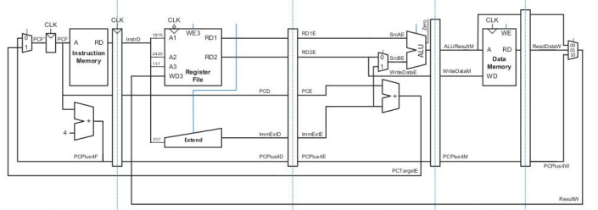
Basic design overview
Write
back
Fetch
Decode
Execute
Memory

Slide 4
Theoretical analysis
Instructions
Components
Hazards
There are 3 types of instructions that are being used in a MIPS architecture:
R-type (add, sub, or, slt)
I-type (addi, lw)
J-type (used for jump/branch)
The main components of the MIPS architecture are:
Instruction Memory
Register file
Decoders
Sign Extension
Control Unit
There are also 3 types of hazards in this architecture:
Structural Hazards
Control Hazards
Data Hazards

Slide 5
Theoretical analysis (Instructions)
R-type
Op(6 bits) | Rs (5 bits) | Rt (5 bits) | Rd (5 bits) | Shamt (5 bits) | Funct (6 bits)
Operation code. Always 0 in R-type instructions. Operation is defined by funct | First source register | Second source register | Destination register. The result will be stored here | Shift amount. Used in only in logical shifting instructions | Function code. Determines the operation that will be performed in the ALU
Example
Add $t0, $t1, $t2
000000 | 01001 | 01010 | 01000 | 00000 | 100000

Slide 6
Theoretical analysis (Instructions)
I-type
Op(6 bits) | Rs (5 bits) | Rt (5 bits) | Immediate (16 bits)
Operation code. Specifies the type of operation (addi, lw, beq etc.) | Source register | Destination register | Constant value or offset (signed or unsigned) depending the instruction
Example
Addi $t0, $t1, 5
001000 | 01001 | 01000 | 0000000000000101

Slide 7
Theoretical analysis (Instructions)
J-type
Op (6 bits) | Address (26 bit)
Operation code | Target address
Example
j 0x00400020
000010 | 0x00100008

Slide 8
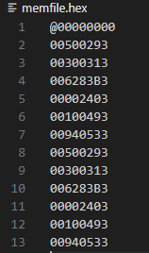
Theoretical analysis (Components)
Instruction Memory
It’s a read-only memory (ROM) that stores the hexadecimal values of the instructions that are going to be executed.
addi x5, x0, 5 # x5 = 5 (I-type)
addi x6, x0, 3 # x6 = 3
add x7, x5, x6 # x7 = x5 + x6 = 8 (R-type)
lw x8, 0(x0) # Load word from x0 to x8
addi x9, x0, 1 # x9 = 1
add x10, x8, x9 # x10 = x8 + 1

Slide 9
Theoretical analysis (Components)
Register File
Sign extension
Control Unit
Contains 32 general purpose 32-bit registers. By consensus, register x0 is initialized to 0 and cannot be written.
Corrects the format of a regular 32-bit instruction to an I-type instruction and incorporates signed numbers format for immediate operations.
Produces the signals needed for each operation and defines how data will move around between memory, registers and the ALU.

Slide 10
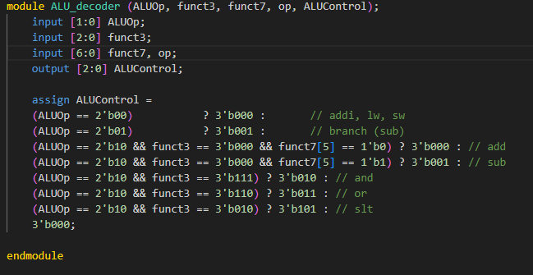
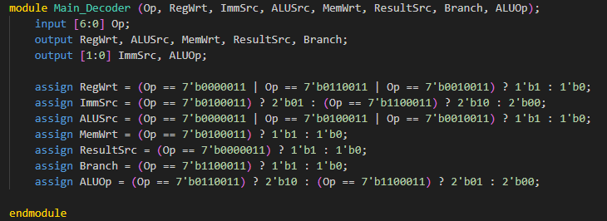
Theoretical analysis (Components)
ALU Decoder
Decodes the instructions for specific ALU operations
Main Decoder
Decodes the instructions for the rest of the operations

Slide 11
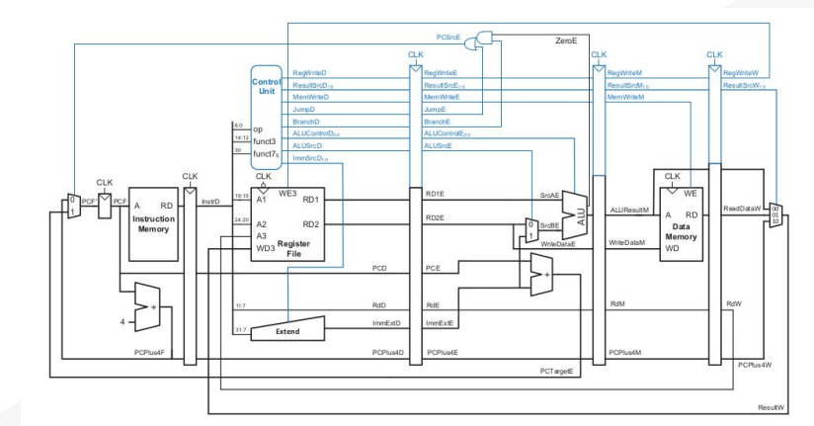
Design Datapath

Slide 12
Theoretical analysis (Hazards)
Structural Hazard
Control Hazard
Data Hazard
They happens when hardware
resources are insufficient to
handle all the instructions in
the pipeline at once.
E.g.: Two instructions want to
access memory at once. One
for fetch and on for load.
Solutions:
Hardware duplication
Stalling
Scheduling
They occur due to branch or jump instructions. The processor doesn't know which instruction to fetch next because it hasn’t resolved if the branch was taken or not.
Solutions:
Branch prediction
Delayed Branch
Stalling
Speculative execution
They take place when an
Instruction depends on the
result of a previous instruction
that hasn’t completed yet.
Solutions:
Forwarding
Stalling
Compiler scheduling

Slide 13
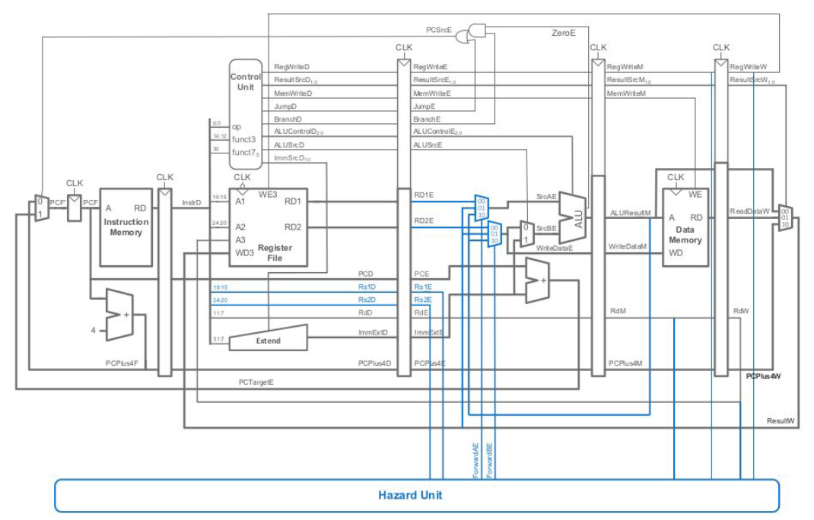
Improved Design

Slide 14
Forwarding logic
Control Signal | Source | Explanation
ForwardA = 00 | Decode/Execute cycle | The first operand comes from the register file.
ForwardA = 10 | Execute/Memory cycle | The first operand is forwarded from the prior ALU result.
ForwardA = 01 | Memory/Writeback cycle | The first operand is forwarded from data memory or earlier ALU result.
ForwardB = 00 | Decode/Execute cycle | The second operand comes from the register file.
ForwardB = 10 | Execute/Memory cycle | The second operand is forwarded from the prior ALU result.
ForwardB = 01 | Memory/Writeback cycle | The second operand is forwarded from data memory or earlier ALU result.

Slide 15
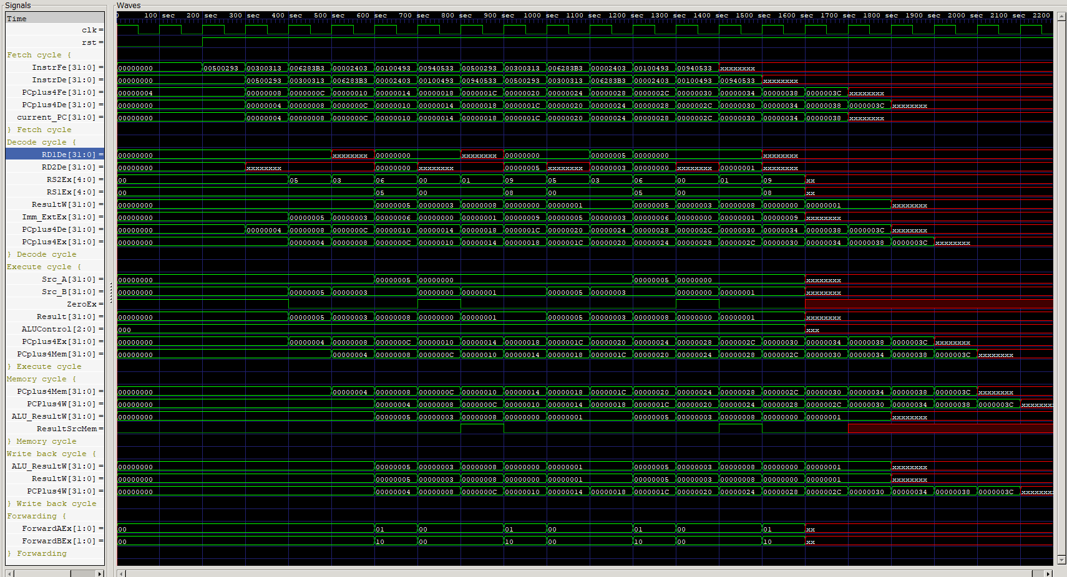
Results

Slide 16
Next Steps
Increase the number of instructions supported from the ALU
Add a jump instruction
Improve the hazard unit to handle all kind of hazards (Structural and control)
Make the design synthesizable

Slide 17
Thank you

